Slide 1
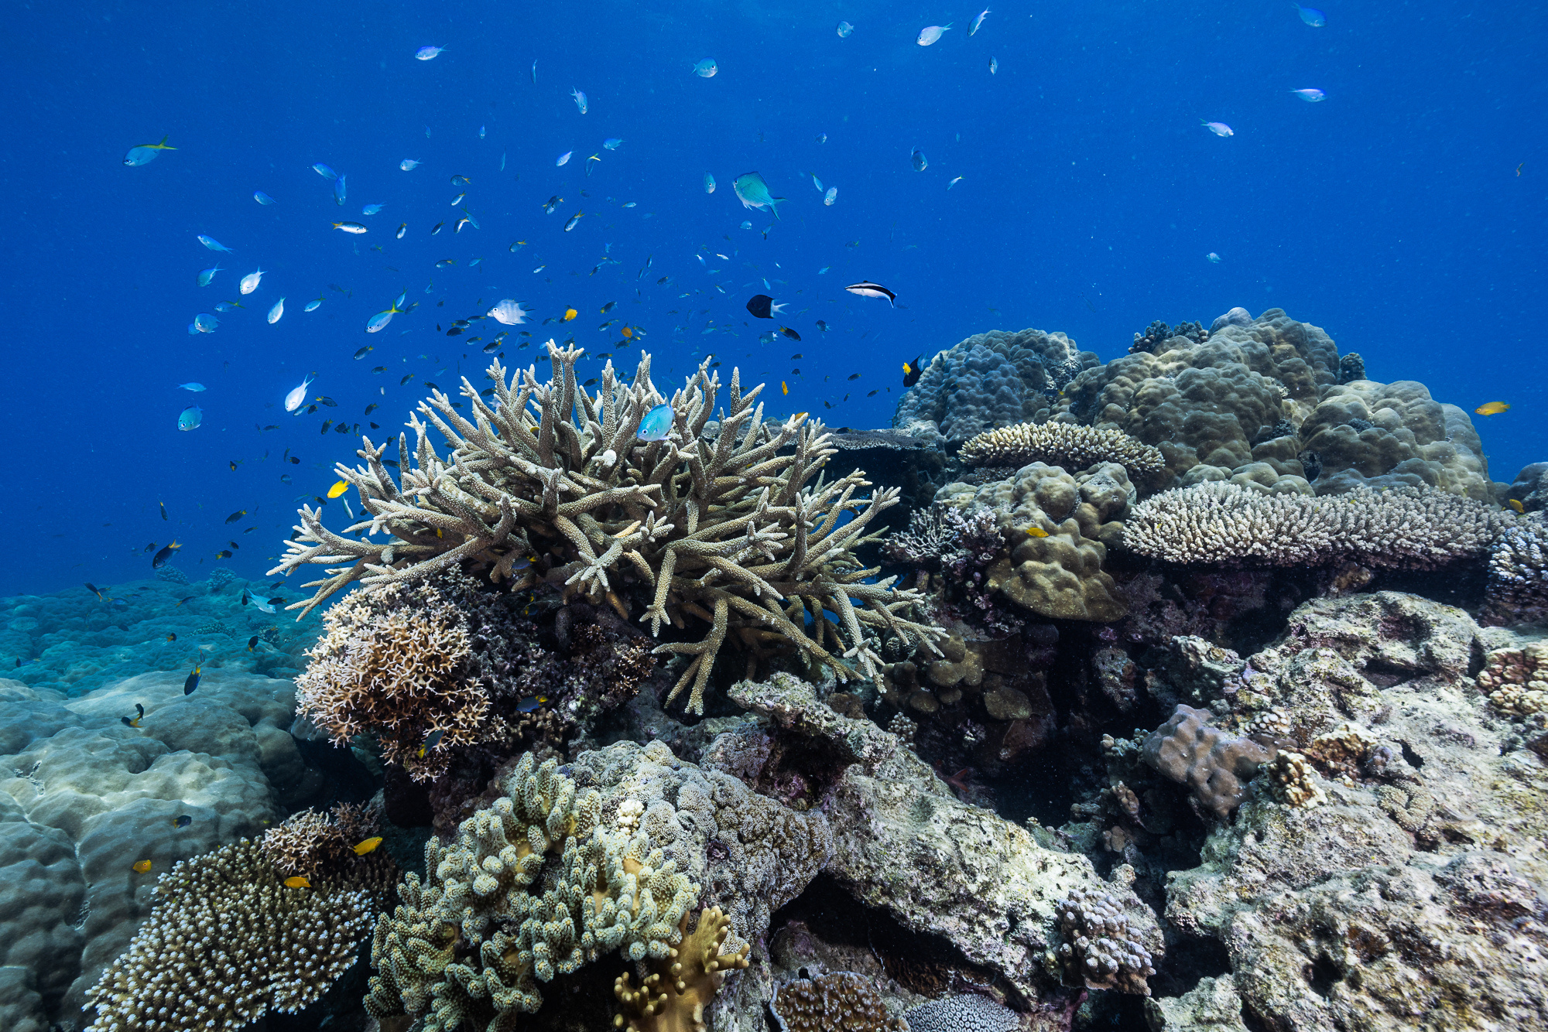

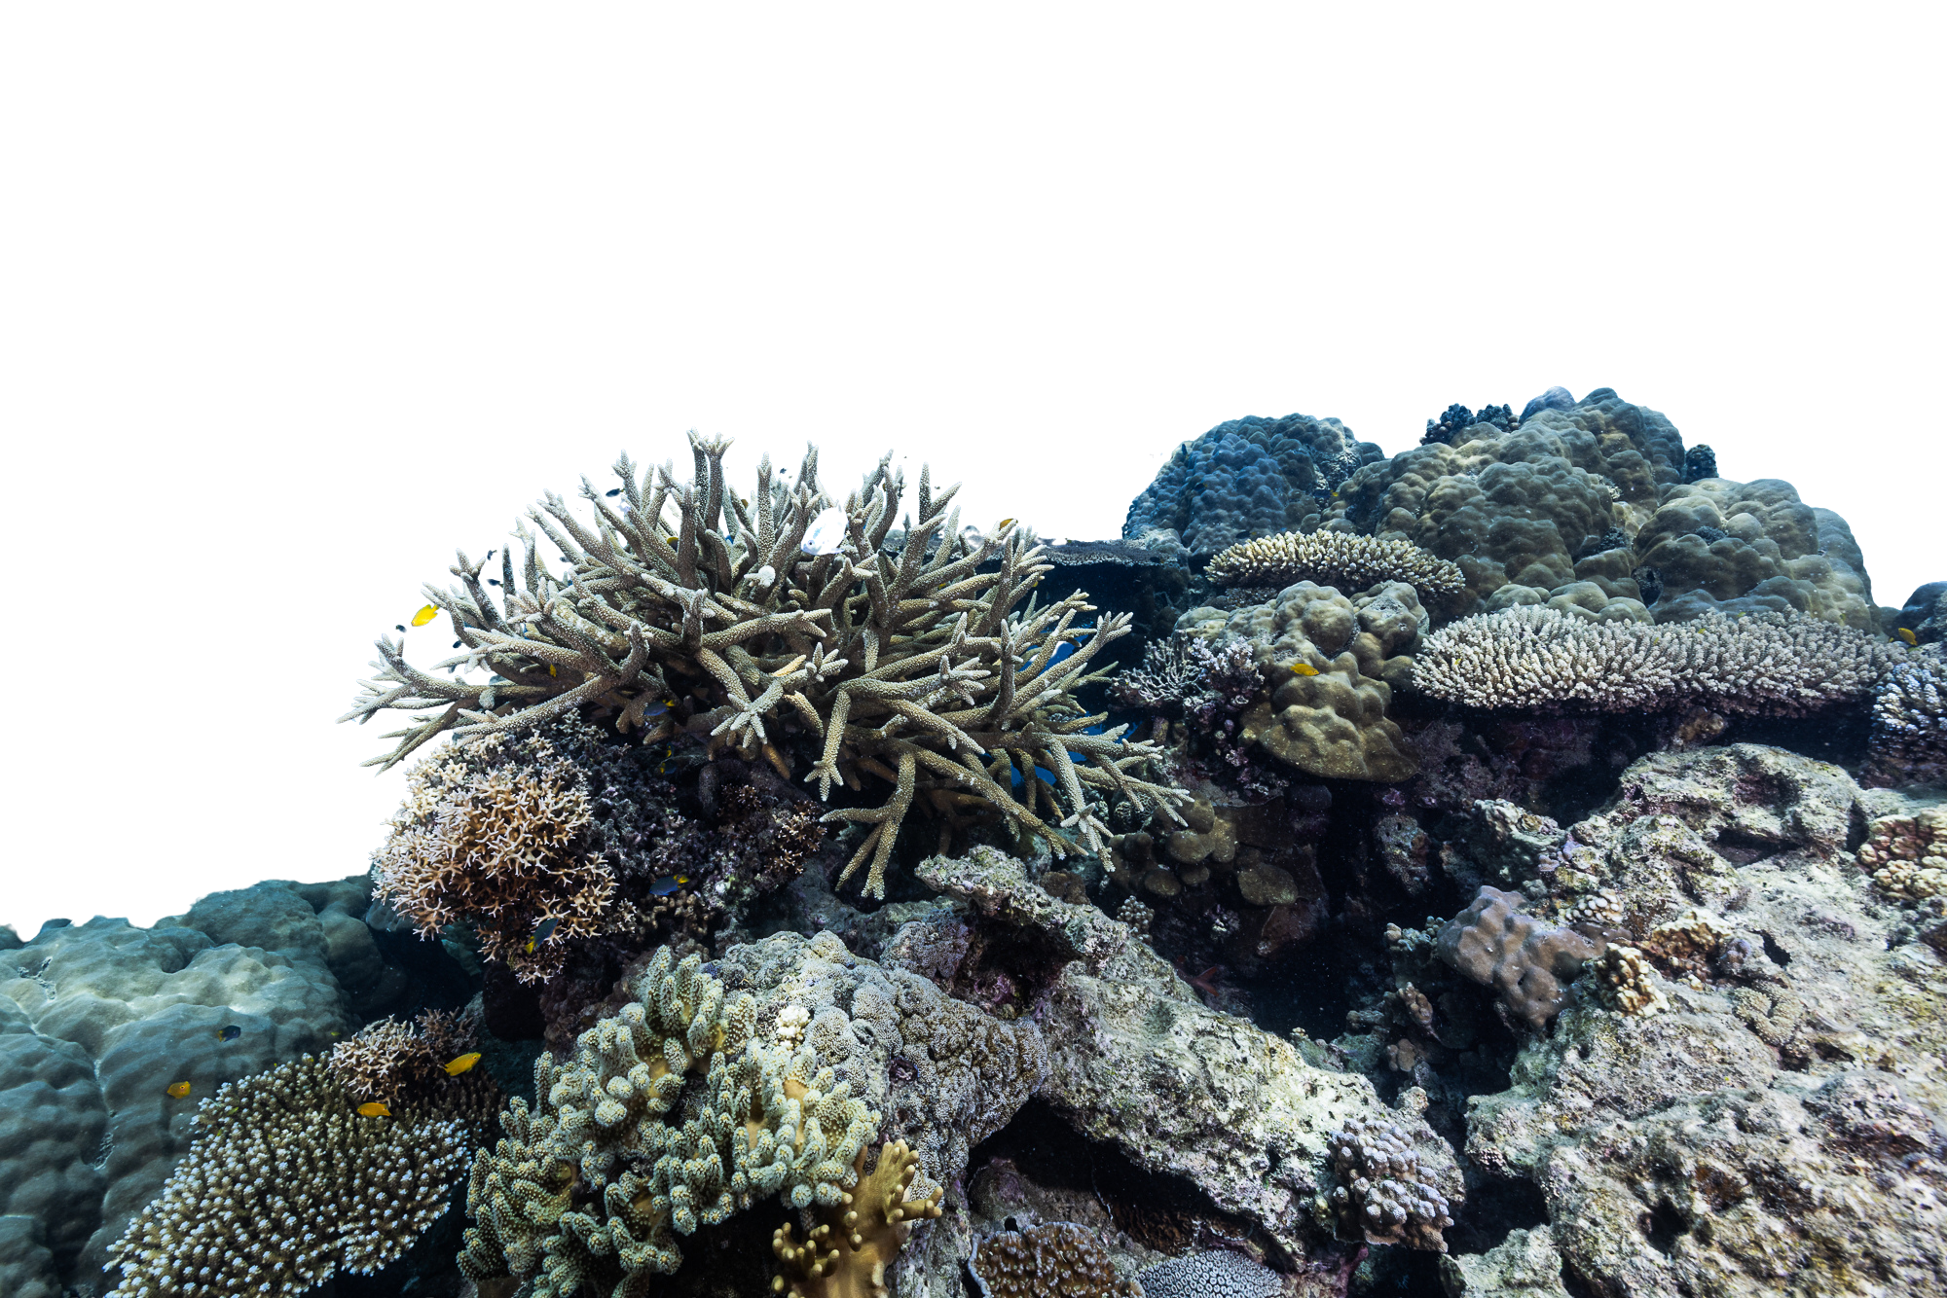

Image credit: Harriet Spark
Ellison Reef: The Reef That Saved Them All
Education Pack

Slide 2
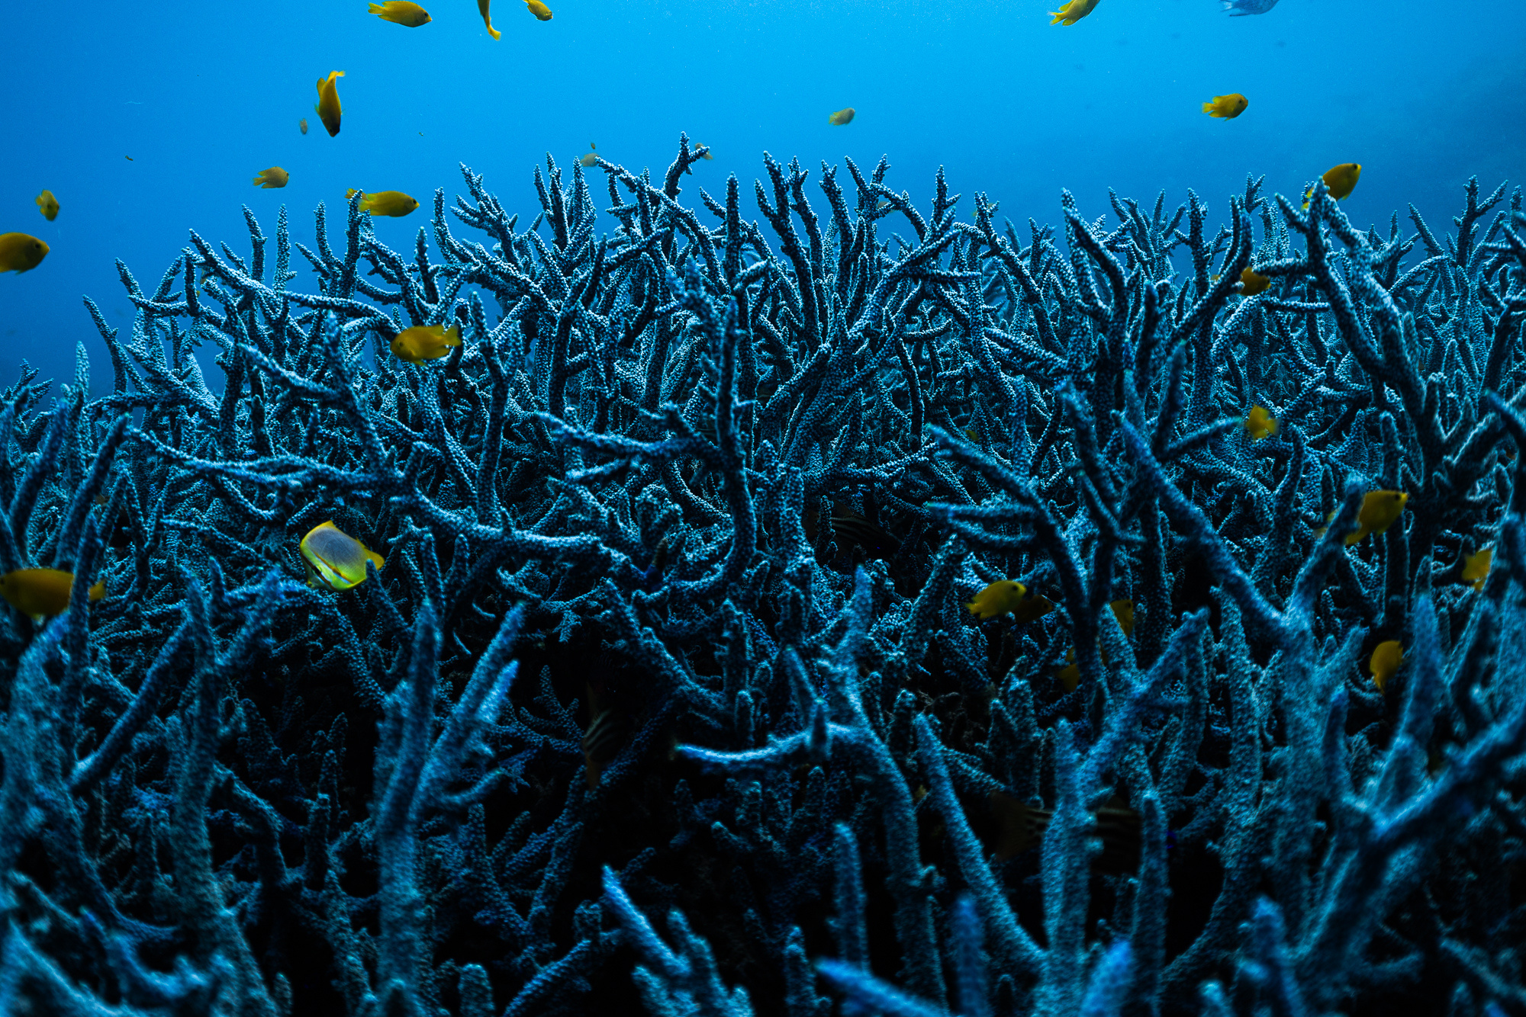

Online Education Pack
This Education Pack has been designed for educators across Australia to support the AMCS’ film Ellison Reef: The Reef That Saved Them All.
Teachers may use each section as a one-hour lesson or pick and choose activities that suit the needs of their students. These materials have been developed to align to the F-10 Australian Curriculum:
  Science, and Humanities and Social Sciences, Years 2-10
  Critical and creative thinking (General Capability)
  Ethical Understanding (General Capability)
  Sustainability (Cross-curriculum priority)
Image credit: Harriet Spark

Slide 3
  Why are reefs important?
  Create a mindmap of the reasons why reefs are important.
  Research the coral and marine life species that live on the Great Barrier Reef.
  Illustrate and label a map of the Great Barrier Reef. Include at least 3 species of coral or fish that live here.
  Read about a restoration project the Yirrganydji Rangers undertook in 2024 here. Create a poster about the Indigenous Rangers who care for sea country on the Great Barrier Reef.
  According to the film, Return to Ellison Reef, how did the AMCS begin and what is the significance of the original campaign to stop mining at Ellison Reef?
Sources: marineconservation.org.au/fight-for-our-reef/

Slide 4
2. Threats & Solutions
  Create a Venn diagram showing the similarities and differences between what Ellison Reef was facing in 1976 and the threats it faces today.
  Imagine you are an advocate for the AMCS. How would you build public awareness of the importance of our reefs? Try to come up with at least 3 ideas.
  Write a newspaper article outlining the different threats to our Reef.
  Research the 1967 Return to Ellison Reef campaign and create an infographic summarising its key facts, goals, and outcomes.
  Sources
  marineconservation.org.au/cutting-plastic-pollution-at-the-source/
  marineconservation.org.au/actions/global-plastics-treaty/
  marineconservation.org.au/unwrapped-plastic-australian-supermarkets/
  marineconservation.org.au/pollution-great-barrier-reef/
  marineconservation.org.au/how-adding-your-name-to-a-petition-has-an-impact/
  abc.net.au/news/2017-10-15/great-barrier-reef-50-years-on-campaigners-return-ellison-reef/9050106
  marineconservation.org.au/fight-for-our-reef/
  marineconservation.org.au/marine-parks-2/
  marineconservation.org.au/coral-bleaching
  marineconservation.org.au/fisheries/

Slide 5
2. Threats & Solutions
  Matching activity: Match threats to solutions (eg. plastic pollution = reduce my plastic consumption / unsustainable fishing = only buying fish from sustainable sources).
  Ranking activity: Students rank threats to the GBR from what they think is most damaging to least damaging. They may discuss their reasons why.
  Solution cards: In groups, students receive solution cards: Coral nurseries & reef restoration, Water quality improvement, Indigenous Sea Country management, Marine park zoning, Climate action (global) Each group answers: How does this help Ellison Reef specifically? Short-term or long-term solution? Who is responsible?
  Shark Tank: Reef Edition. In groups, students pitch one solution
in 30 seconds.

Slide 6
3. Individual & community action
  Brainstorm: What are some other solutions you can think of to preserve the unique environment of the Great Barrier Reef?
[Facilitators should encourage students to cover all possible solutions, including reducing plastic, sustainable seafood,
volunteering, donating, signing digital petitions, engaging with local government, supermarket audits and tree
planting/wetland restoration projects].
  Who is your local Federal MP? Use this website to find your local Federal MP. Draft an email to your local member outlining the action you would like them to take to conserve the Great Barrier Reef.
  Design a board game for students your age to play that brings together
everything you have learnt about protecting the Great Barrier Reef.
Sources: abc.net.au/education/abc-730-ellison-reef-has-it-been-saved/14006580

Slide 7
3. Individual & community action
  Are there any tree planting or wetland restoration projects occurring in your local area? Conduct research through your local council and take part in grassroots volunteering opportunities available to you.
  Have a look at the Australian Marine Conservation Society Fight for Our Reef Take Action page. Send a message or add your name to a cause of your choice - with your teacher and guardian’s permission of course!
  The film mentions the work of “citizen scientists.” What is a citizen scientist?
  Are there any citizen scientist projects that you could be a part of in
  your local area? How could you find out about them?
Sources: abc.net.au/education/abc-730-ellison-reef-has-it-been-saved/14006580

Slide 8
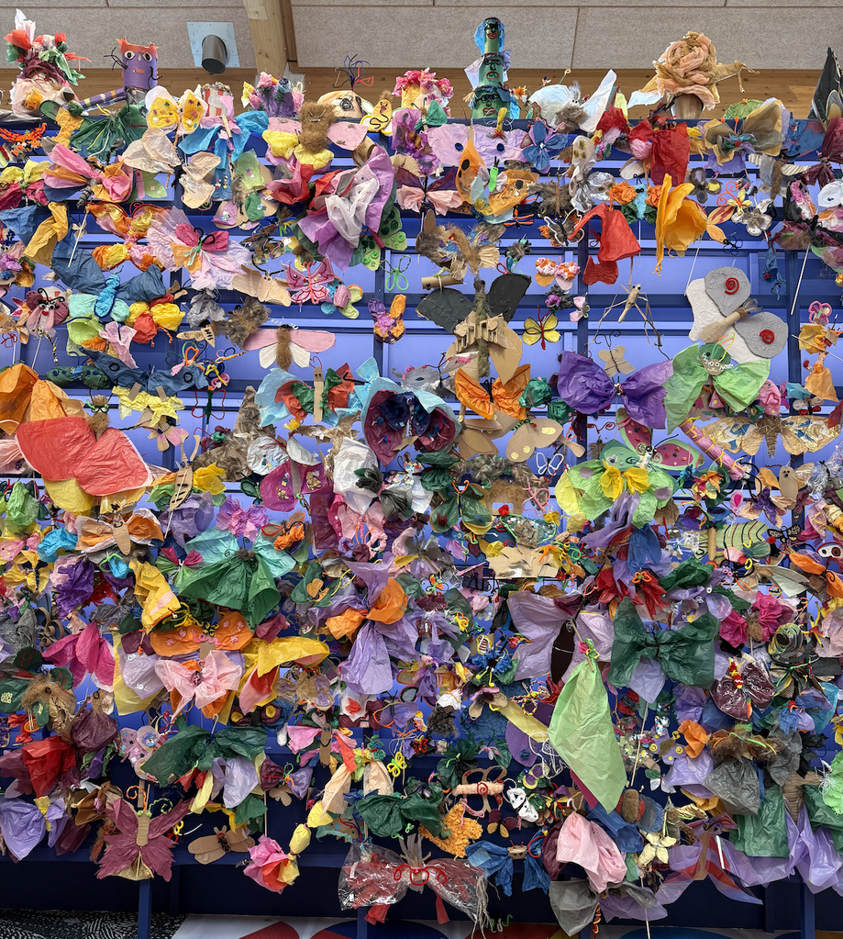
4. Creating a coral reef
Students create coral or marine life from various craft resources: crepe paper, pipe cleaners, feathers, coloured paper etc.
They may add their creation to a “reef wall” within the classroom.
On each creation, they will write one action they commit to taking to preserve marine life / the Great Barrier Reef specifically.

